Slide 1
Lecture 1 Introduction to Software Engineering
Engr. Mobeen Nazar
Lecturer
Software Engineering Department

Slide 2
Who am I?
“
Engr. Mobeen Nazar
Lecturer, Department of Software Engineering
E-mail: mobeennazar.bukc@bahria.edu.pk

Slide 3
Course Objective
After completing the course, the students will be able to:
Understand software development as a series of engineering activities.
Develop team-working skills.
Analyze client/user needs.
Understand and effectively use the appropriate life cycle and process model for the development of software product.

Slide 4
Course Outline
Software construction
Software metrics
Process models
Risk Management
Software estimation
UML diagrams
Software testing.

Slide 5
Recommended Books
Text Book:
Software Engineering: A Practitioner’s Approach, 8/e by Roger S. Pressman
Reference:
Software Engineering, 9/e, Ian Somerville (2010)
A Discipline for Software Engineering, Watt S. Humphrey
Essentials of Software Engineering , Frank Tsui (2014)

Slide 6
Course Policy
Attendance
Students are expected to attend all classes
Attendance is compulsory and will be taken regularly.
Attendance for less than 80% of the lectures will result in students being barred from taking the Final Exam.

Slide 7
Class Rules
Cell phones are restricted during class.
Cell phones must be turned off during the lecture.
No discussion with each other during lecture
Maintain discipline.

Slide 8
Course Material
▷ All course material, assignments , quizzes and announcements will be there _LMS_

Slide 9
Course Assessment
Assessment Criteria
Mid – Term
Final Exam
Quizzes (2-3)
Class Assignments (2 - 4)
20%
50%
10%
20%

Slide 10
Objective
An Introduction to SE
Software Engineering as defined by IEEE
Attributes of a good software
Participants & Roles
Work products
Layered Approach
Software Applications
Software Myths
SDLC
Software – New Categories
Software Process.
Software Model
Software Tools

Slide 11
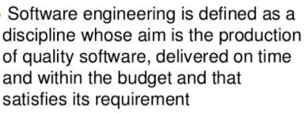
What is Software Engineering?

Slide 12
Software Engineering
The IEEE definition:
Software Engineering:
– The application of a systematic, disciplined, quantifiable approach to the development, operation, and maintenance of software; that is, the application of engineering to software.
16

Slide 13
Software Engineering
Software is:
(1) instructions (computer programs) that when executed provide desired features, function, and performance;
data structures that enable the programs to adequately manipulate information and
documentation that describes the operation and use of the programs.
For example, these documents might include, business cases, project status reports, and project requirement sheets.

Slide 14
An Introduction to SE
Software Activities
Software specification: customers and engineers define the software that is to be produced and the constraints on its operation.
Software development : the software is designed and programmed.
Software validation : the software is checked to ensure that it is what the customer requires.
Software evolution : the software is modified to reflect changing customer and market requirements.
15

Slide 15
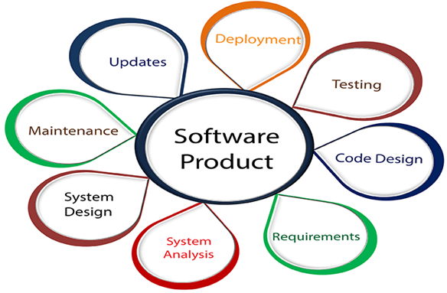
Software Engineering

Slide 16
What is Good Software
General characteristics
Functionality
Usability: Users should be able to learn and use a system easily.
Maintainability
Dependability
Efficiency: The less resource a piece of software uses, the better. .
Good software products require good programming
Notes:
The dependability of a system reflects the user’s degree of trust in that system.
availability, reliability, safety and security.

Slide 17
Essential attributes of good software
Product characteristic | Description
Maintainability | Software should be written in such a way so that it can evolve to meet the changing needs of customers. This is a critical attribute because software change is an inevitable requirement of a changing business environment.
Dependabili ty and security | Software dependability includes a range of characteristics including reliability, security and safety. Dependable software should not cause physical or economic damage in the event of system failure. Malicious users should not be able to access or damage the system.
Efficiency | Software should not make wasteful use of system resources such as memory and processor cycles. Efficiency therefore includes responsiveness, processing time, memory utilisation, etc. Efficiency measures the degree to which software makes good use of the hardware resources available to it.
Acceptability | Software must be acceptable to the type of users for which it is designed. This means that it must be understandable, usable and compatible with other systems that they use.

Slide 18
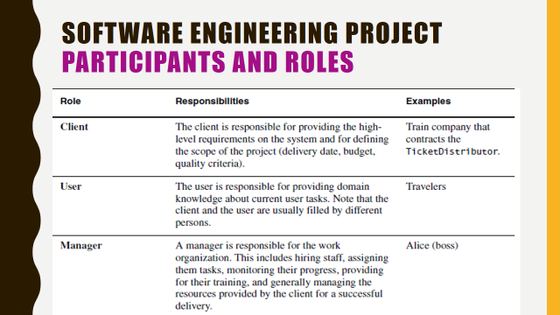
Participants & Roles

Slide 19
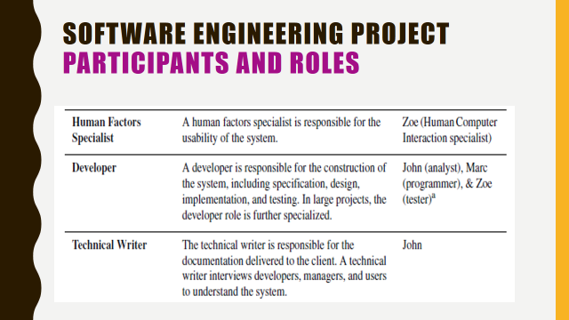
Participants & Roles

Slide 20
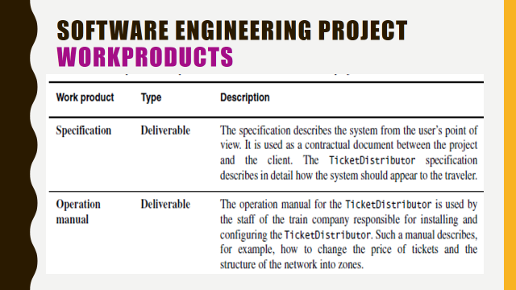
Manual Types
a document that describes in detail the processes and systems
that a company uses to produce its goods and provide its services:

Slide 21
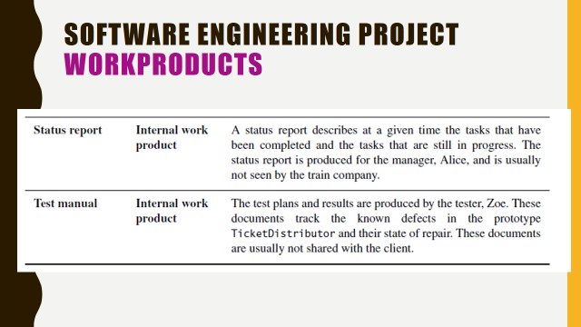
Test manuals are in need of improvement.A test manual should contain such
information in the form of a brief history of the test.

Slide 22
example of status report include the attributes regarding projects:
program
reporting period
reporting date
program manager
sponsors
ststus ,scope , budget etc.
Types of manual testing are given below:
White Box Testing.
Black Box Testing.
Gray Box Testing.

Slide 23
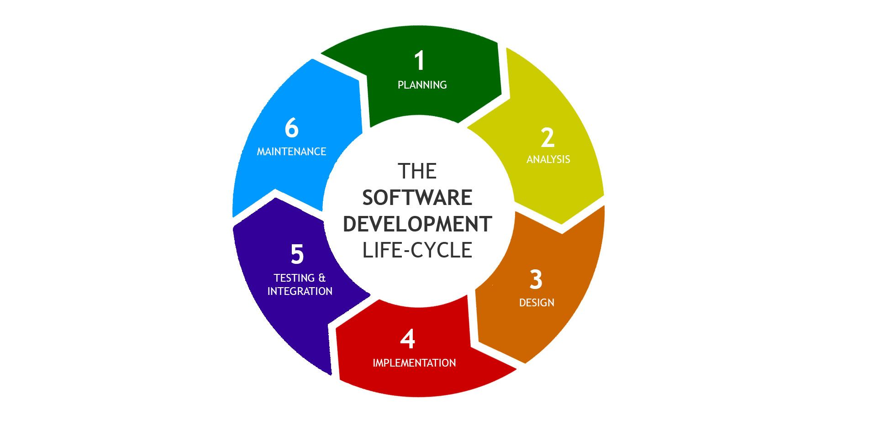
SDLC (Software Development Life Cycle)

Slide 24
SDLC Phases
Given below are the various phases:
Requirement gathering or planning
Analysis
Design
Implementation
Testing & Integration
Maintenance

Slide 25
1) Requirement gathering (Planning)
During this phase, all the relevant information is collected from the customer to develop a product as per their expectation.
Any ambiguities must be resolved in this phase only.

Slide 26
2) Analysis
An analysis is done to check the feasibility of the development of a product.
In case of any ambiguity, a call is set up for further discussion.

Slide 27
3) Design
In this phase, the requirement gathered in the SRS document is used as an input and software architecture that is used for implementing system development is derived.
A software requirements specification (SRS) is a document that describes what the software will do and how it will be expected to perform.

Slide 28
4) Implementation
Implementation/Coding starts once the developer gets the Design document.
The Software design is translated into source code. All the components of the software are implemented in this phase.

Slide 29
5) Testing
Testing starts once the coding is complete and the modules are released for testing. In this phase, the developed software is tested thoroughly and any defects found are assigned to developers to get them fixed.
Retesting, regression testing is done until the point at which the software is as per the customer’s expectation. Testers refer SRS document to make sure that the software is as per the customer’s standard.

Slide 30
6) Maintenance
After the deployment of a product on the production environment, maintenance of the product i.e. if any issue comes up and needs to be fixed or any enhancement is to be done is taken care by the developers.

Slide 31
The Three-way Trade-off
▷Competing goals Every software project has a trade-off between functionality, cost, and time.
▷ Extra functionality adds extra costs for testing development, maintenance, etc.

Slide 32
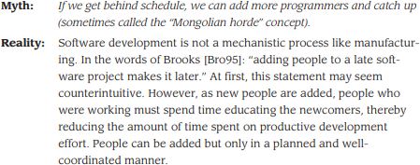
Software Myth
22

Slide 33

Software Myth
23

Slide 34
Software—New Categories
Open world computing—pervasive, distributed computing,
Creating software to allow machines of all sizes to communicate with each
other across vast networks
Ubiquitous computing—wireless networks,
to appear anytime and everywhere.
computing is made
Net-sourcing—the Web as a computing engine, Architecting simple and sophisticated applications that benefit targeted end-user markets worldwide
Open source—”free” source code open to the computing community, Distributing source code for computing applications so customers can make local modifications easily and reliably

Slide 35








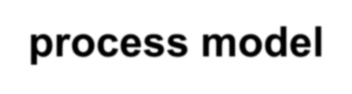

A Layered Technology
Software engineering encompasses a process, the management of activities, technical methods, and use of tools to develop software products.
tools
Foundation
Bedrock
methods
process model
a “quality” focus
Software Engineering

Slide 36
Software engineering is fully a layered technology, to develop software we need to go from one layer to another. All the layers are connected and each layer demands the fulfillment of the previous layer.

Slide 37
Software Process
The software process forms the basis for:
management control of software projects
establishes the context in which technical methods are applied
work products (models, documents, data, reports, etc.) are produced
milestones are established
quality is ensured
change is properly managed.

Slide 38
Software Method
S/W eng methods provide the technical “how to’s” for building S/W.
Methods encompass a broad array of tasks that include
communication,
req. analysis,
design,
coding,
testing and support.

Slide 39
Software Tools
S/W eng tools provide automated or semi- automated support for the process and the methods.
When tools are integrated so that info. Created by one tool can be used by another,
a system for the support of S/W development called computer-aided software engineering is established.

Slide 40
CASE TOOLS
CASE tools are set of software
application automate
programs, which are used to
SDLC(Systems activities.
Analysis and Design
Life Cycle )
Ex: Analysis | tools, | Design | tools, Project
management | tools, | Database | Management

Slide 41
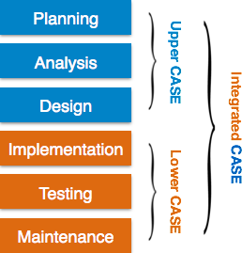
Components of CASE Tools
Upper Case Tools - Upper CASE tools are used in planning, analysis and design stages of SDLC.
Lower Case Tools - Lower CASE tools are used in implementation, testing and maintenance.
Integrated Case Tools - Integrated CASE tools are helpful in all the stages of SDLC, from Requirement gathering to Testing and documentation.

Slide 42
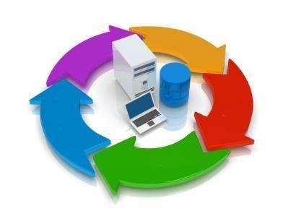
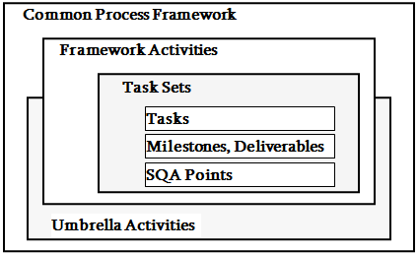





A Process Framework
Process framework
Framework activities
work tasks work products
milestones & deliverables QA checkpoints
Umbrella Activities

Slide 43
Umbrella Activities
Software project management
Formal technical reviews
Software quality assurance
Software configuration management
Work product preparation and production
Reusability management
Measurement
Risk management

Slide 44
Software quality assurance:
Software quality assurance (SQA) is a crucial process that must be implemented during the software development life cycle. The primary purpose of QA is to ensure that the software meets planned functionality, bug-free, and it will be working flawlessly under different circumstances.
This cycle for quality assurance consists of four steps: Plan, Do, Check, and Act.

Slide 45
Formal technical reviews:
The purpose of FTR is to verify that the software meets specified requirements.
To makes the project more manageable.
Configuration management can be used to maintain OS
configuration files. Example systems include
Chef, Nix, Otter, Puppet, Quattor
Terraform, Pulumi and Vagrant.
Software project management is an art and science of planning and leading software projects. It is a sub-discipline of project management in which software projects are planned, implemented, monitored and controlled.

Slide 46
Reusability management:
Define the standards for the reuse of work products (including software components), and develop mechanisms to implement reusable components
Risk management:
Risk management is a series of steps to help software
development teams understand and manage uncertainty
Work product preparation and production:
encompasses the activities required to create
work products such as models, documents, etc.
Measurement consists of the effort required to
measure the software. · The software cannot be measured directly.

Slide 47
Summary
Software engineering is the combination of paperwork and Systematic solution of the addressed problem
Software is first designed then engineered .
Evolution and the maintenance is the essential and the last step of SE

Slide 48
Q/A

